Slide 1


CREDIT EDA CASE STUDY
By : Kaivalya Hemant Kulkarni

Slide 2
Purpose of the Assignment
Credit risk analysis will help the company in deciding if to approve or reject a loan based on the applicant's profile. This in turn helps the company to approve of unnecessary loans that might affect the financial side of the business, that is loss over a long run

Slide 3
Methods and Steps
Sourcing and understanding the data
Checking for error/Null values. Address them and clean the data
Create bins
Do EDA on the current data. The types of analysis done are Univariate, Bivariate, Correlation etc
Merging the current application data with the previous application data
Data Cleaning and analyzing the merged data
Recommendations and Risks

Slide 4
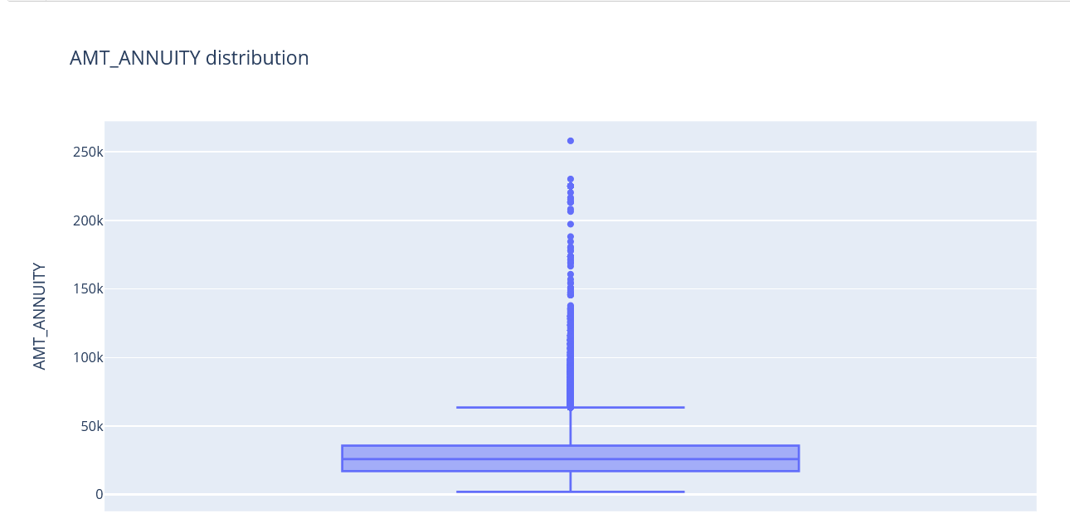
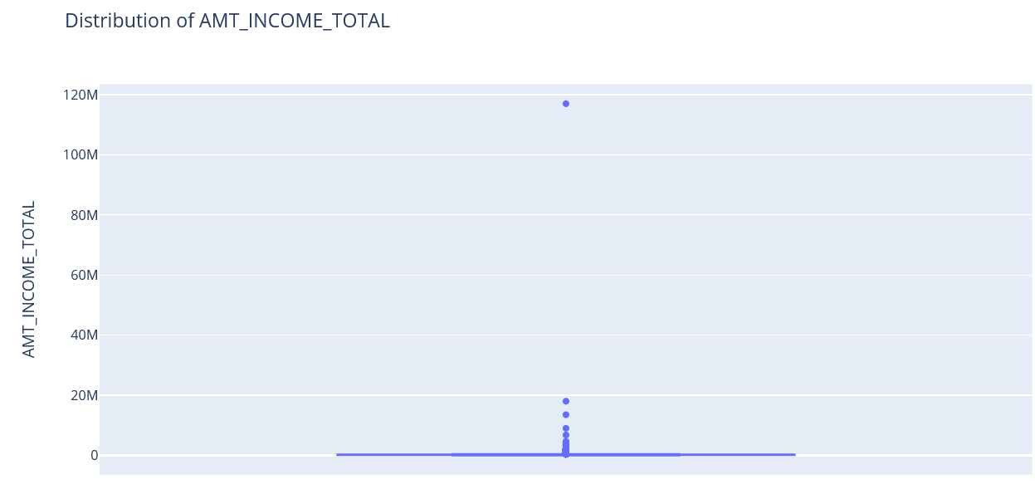
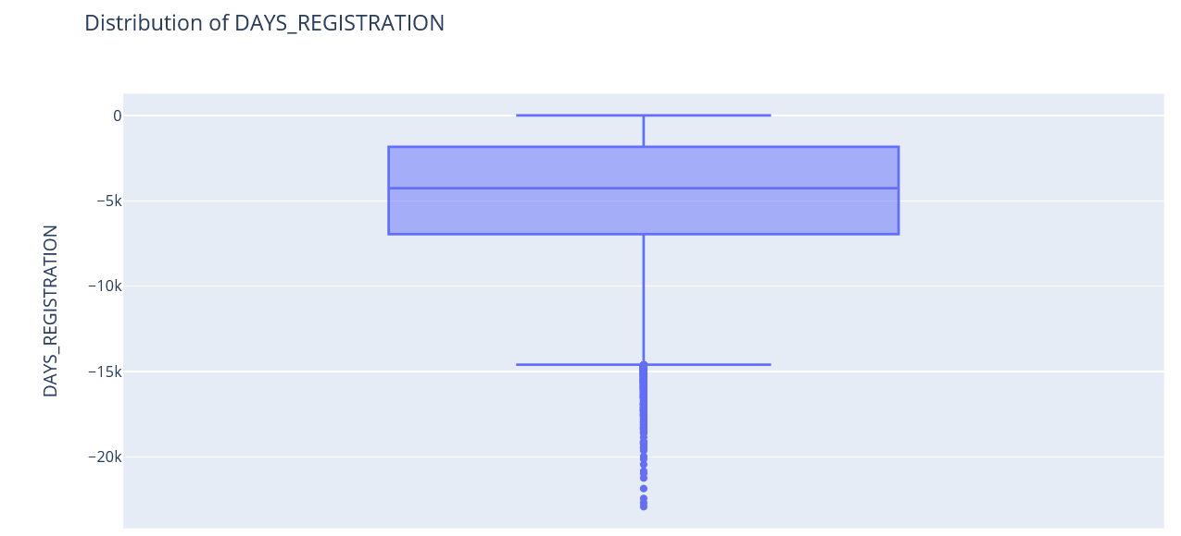
Outliers for the income column

Slide 5
UNIVARIATE ANALYSIS

Slide 6
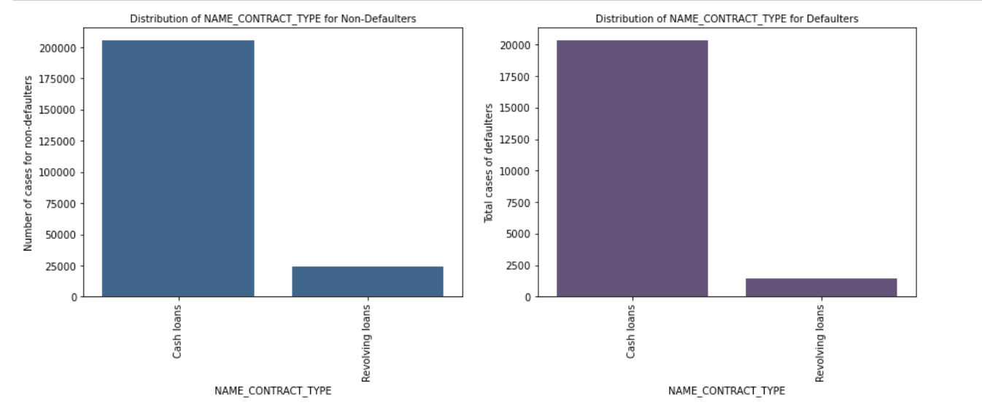
Based on type of loan contract type
Here from the graphs, we can see that Revolving loans are comparatively lesser than the Cash loan in default populations.
This also means that the amount of Cash loans given out are in an extremely large amount, which can be unsafe for the bank in the future.
Resolving loans are comparatively safer than the Cash ones

Slide 7
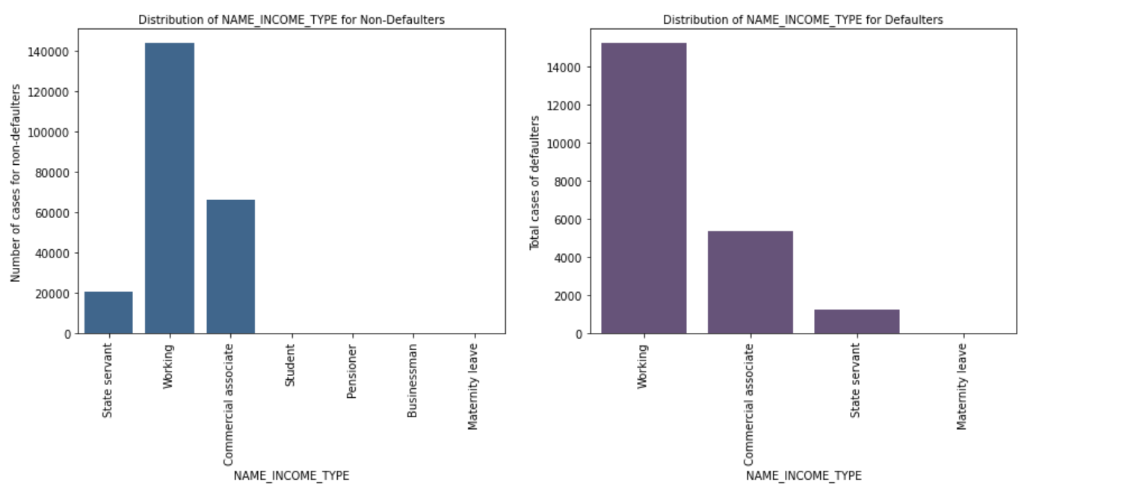
BASED ON INCOME TYPE
From the following graph, we can see that working type/professionals show higher loan default rate

Slide 8
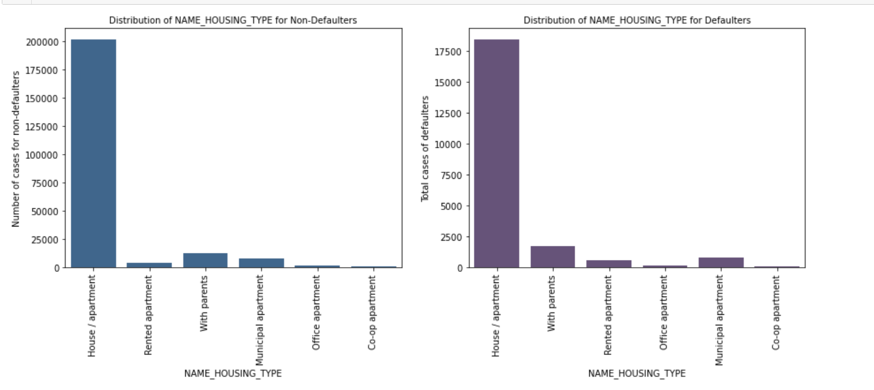
BASED ON HOUSING TYPE
People living in rented apartments as well as people staying with parents have a high default rate
This is since people living on rent have less income and people staying with parents’ do not have enough income to pay for the loan

Slide 9
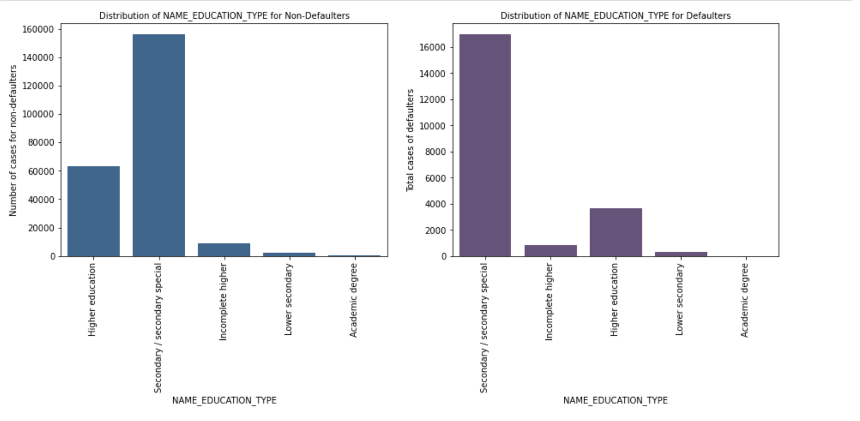
BASED ON TYPE OF EDUCATION
Secondary special and Higher education has a higher rate of taking loans, mostly student loans
But in case of higher education, the default rate is comparatively less due to the fact the income after completing the education is high enough to pay off the loans

Slide 10
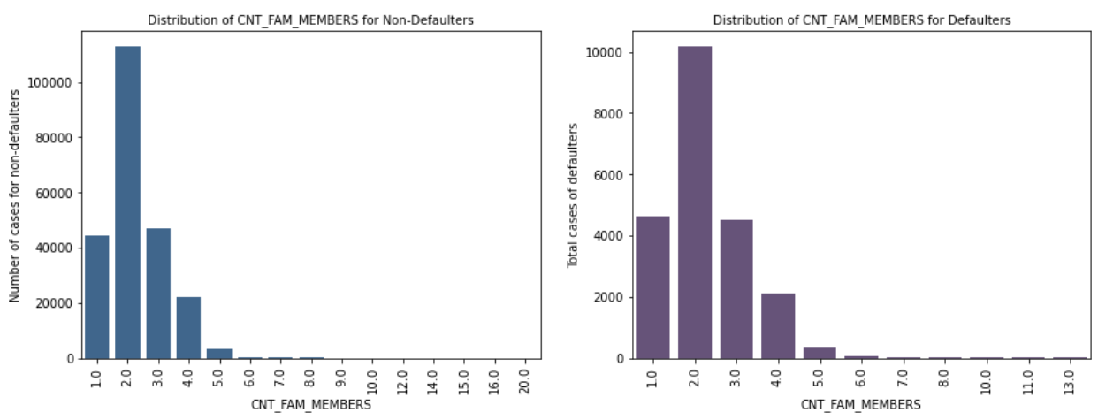
BASED ON COUNT OF FAMILY MEMBERS
The adjacent graph shows that people having higher count of Children's fall in the category of the loan defaulters

Slide 11
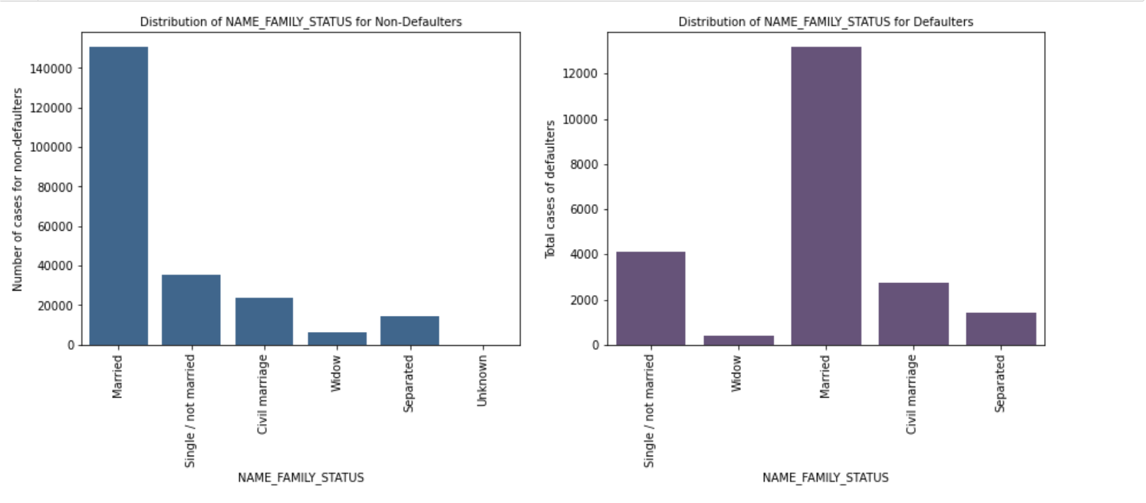
BASED ON THE MARITIAL STATUS
Married People tend to go more towards loans, mainly house and car loans
Even though they are high, generally Married people are the ones that tend to pay off the loans i.e. are non defaulters

Slide 12
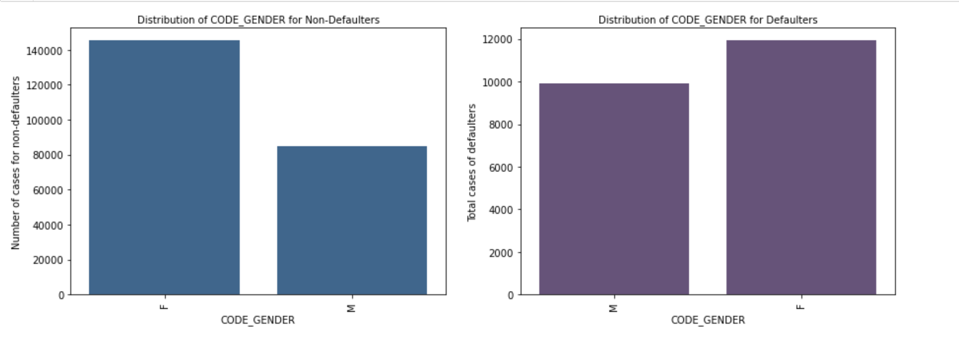
BASED ON GENDER DISTRIBUTION
According to the data, Females tend to take more loans than Males.
But in comparison to amount of loans taken and the defaulters, men are slightly on the higher side

Slide 13
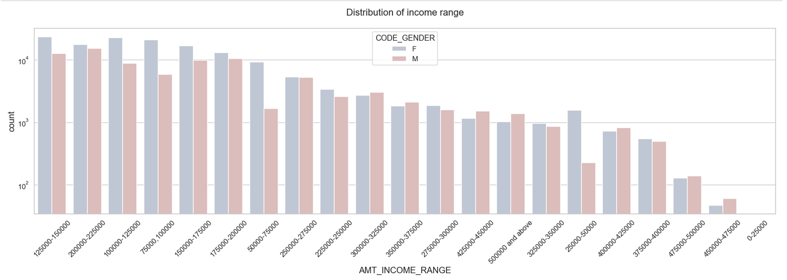
DISTRIBUTION OF INCOME BY GENDERS
The above distribution shows that females have more credit than their male counterpart for a given range
Also, the income ranges of 1,00,000 to 2,00,000 have a higher default rate

Slide 14
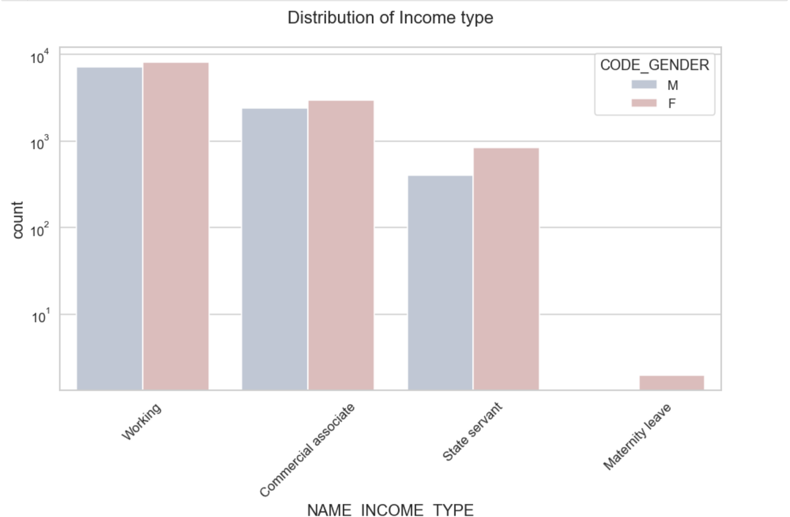
DISTRIBUTION OF INCOME TYPE
The above figure shows that Female have a higher incomes in every sector for a given range for their male counterparts.
This also implies that Females have a higher percentage of falling in the non defaulters category

Slide 15
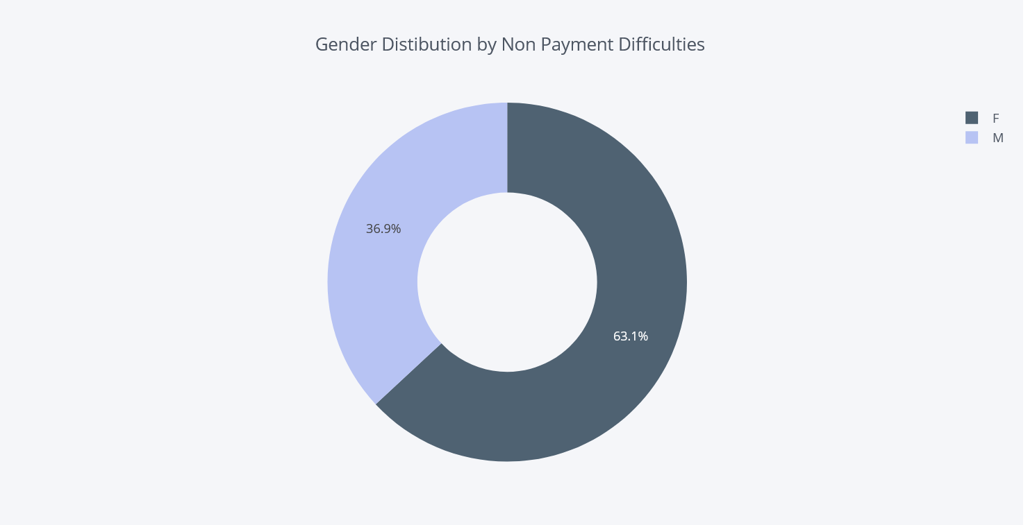
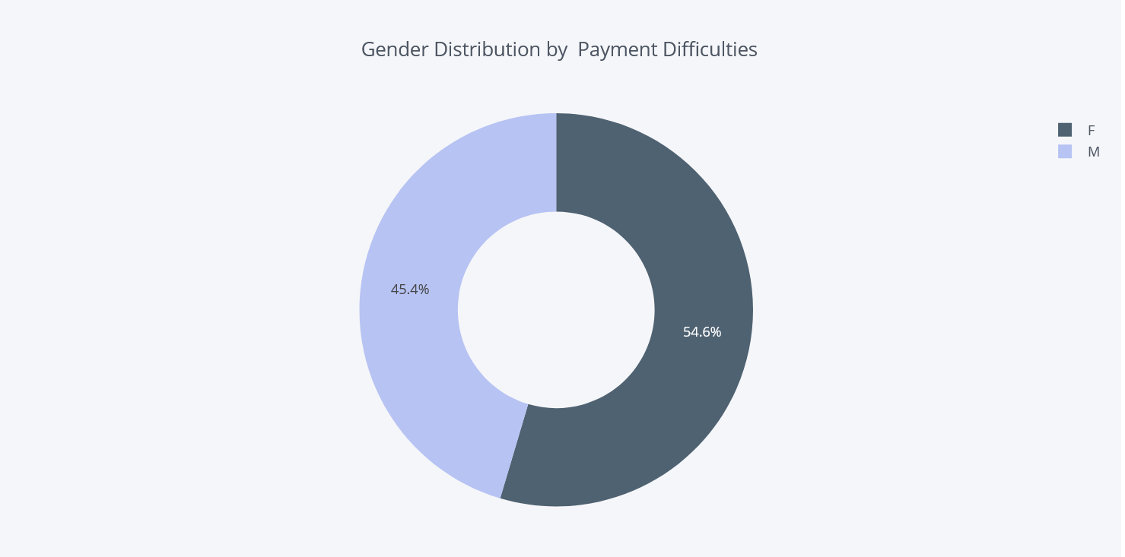
GENDER DISTRIBUTION BY PAYMENT DIFFICULTIES
From the above we can see that Females have a high loan payment rate. Thus, is since they have higher income per range for their male counterpart
On the other hand, Males have a higher rate of Defaulters thus fall into the risky loan category

Slide 16
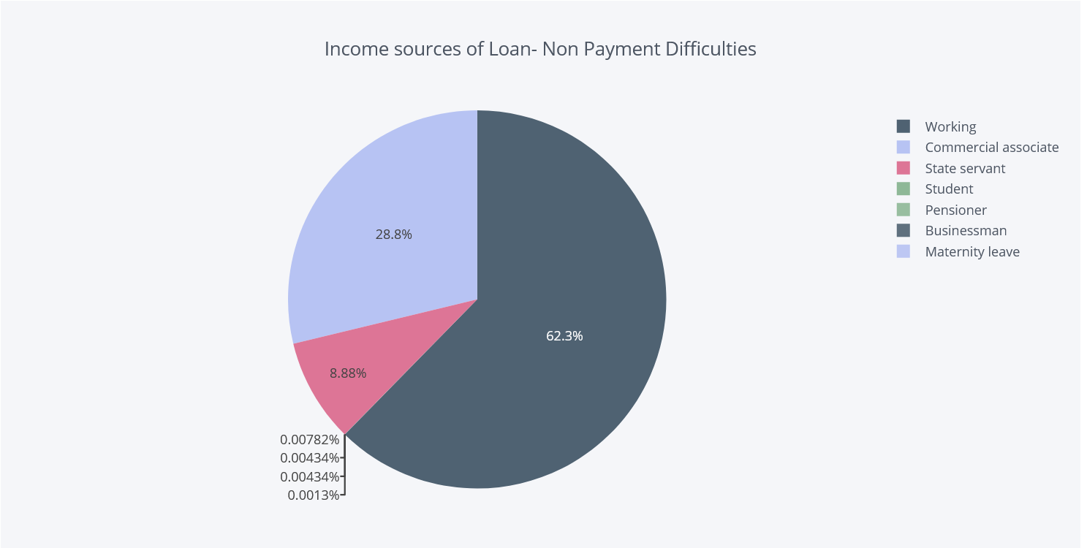
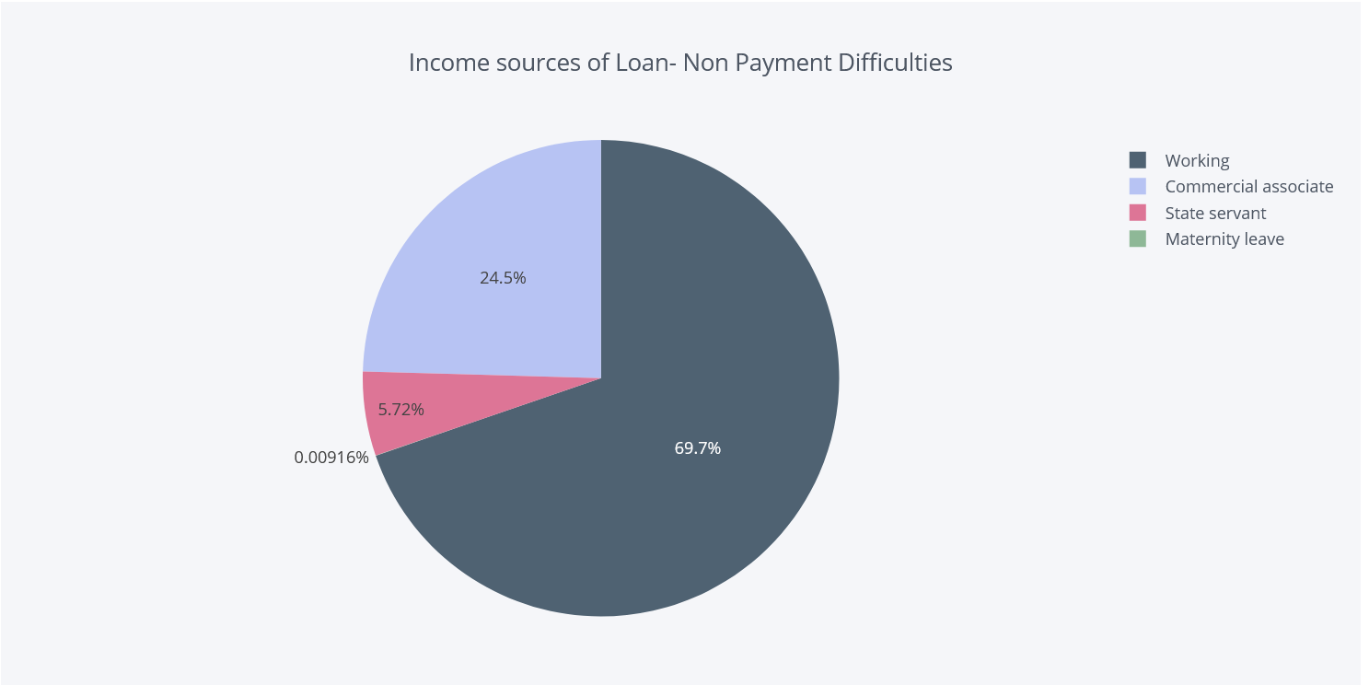
INCOME SOURCES BY PAYMENT DIFFICULTIES
From the above we can see that Businessmen are the ones who take the maximum loans compared to other working class. But since their returns over the time are higher, they don’t have payment difficulties, and thus are safe loans
Comparatively, Normal Working Class also have a high rate of taking loans. Due to the returns not being high and the loans spanning over a long time, they are the highest when it comes to defaulters

Slide 17
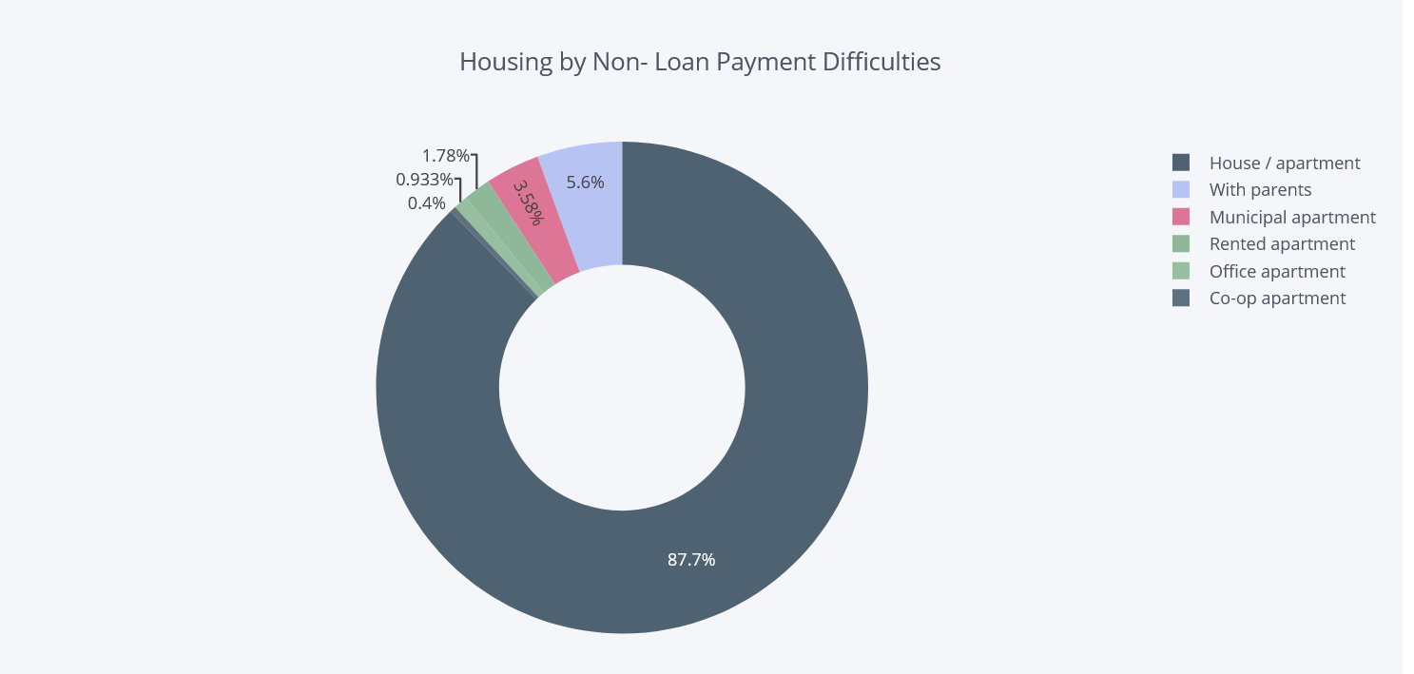
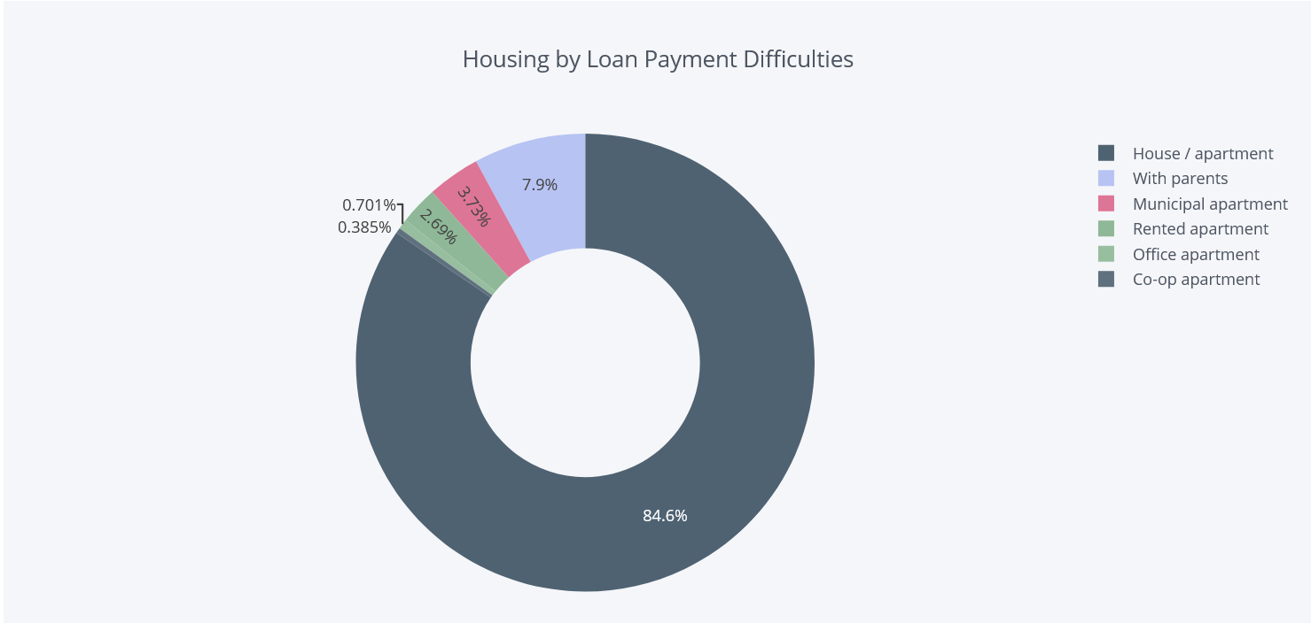
PAYMENT ON BASIS OF HOUSING
From the above pie chart, people living in House/Apartment take maximum amount of loans, i.e. for housing mainly
These loans are spread over higher years, thus the people taking these loans have a mixed population of having payment difficulties as well as those who are non defaulters

Slide 18
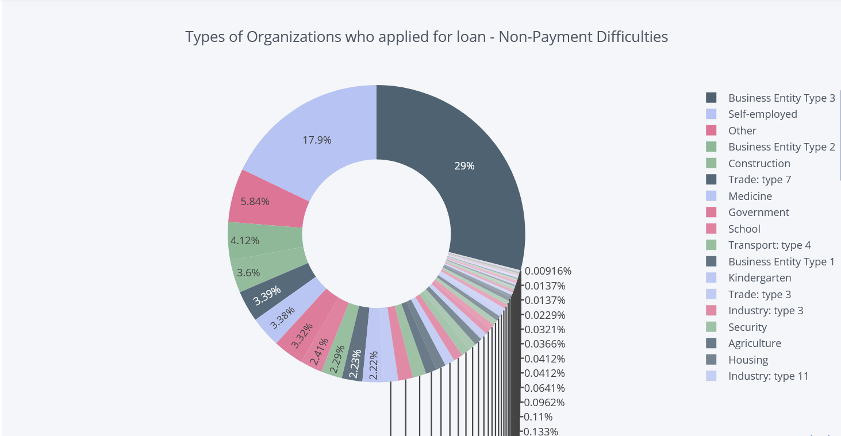
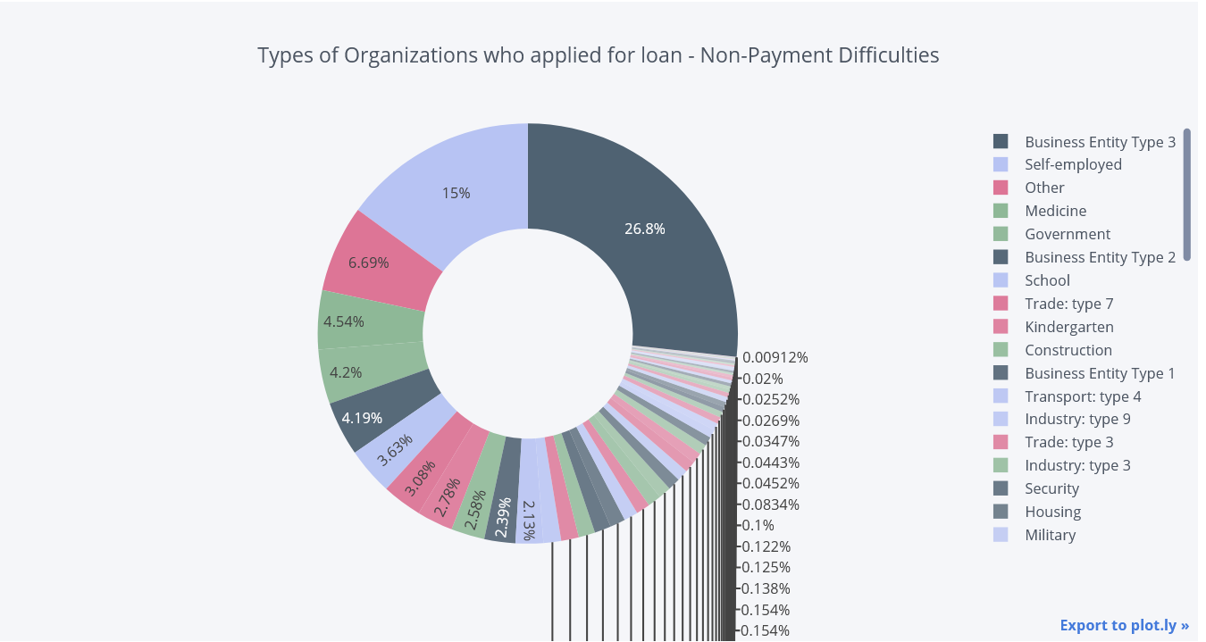
PAYMENT DIFFICULTIES BY ORGANIZATION
The above shows the types of organizations who apply for loans and the defaulter types
Self Employed and Business entity have a higher percentage of people who take loans. These loans are mainly for their business thus there is a high chance of the individuals being able to pay off their loans. But on the flip side, it can go visa versa and thus the same type of organizations are in the higher defaulters list as well

Slide 19
Univariate Analysis of Numerical Variables based on 'Target'

Slide 20
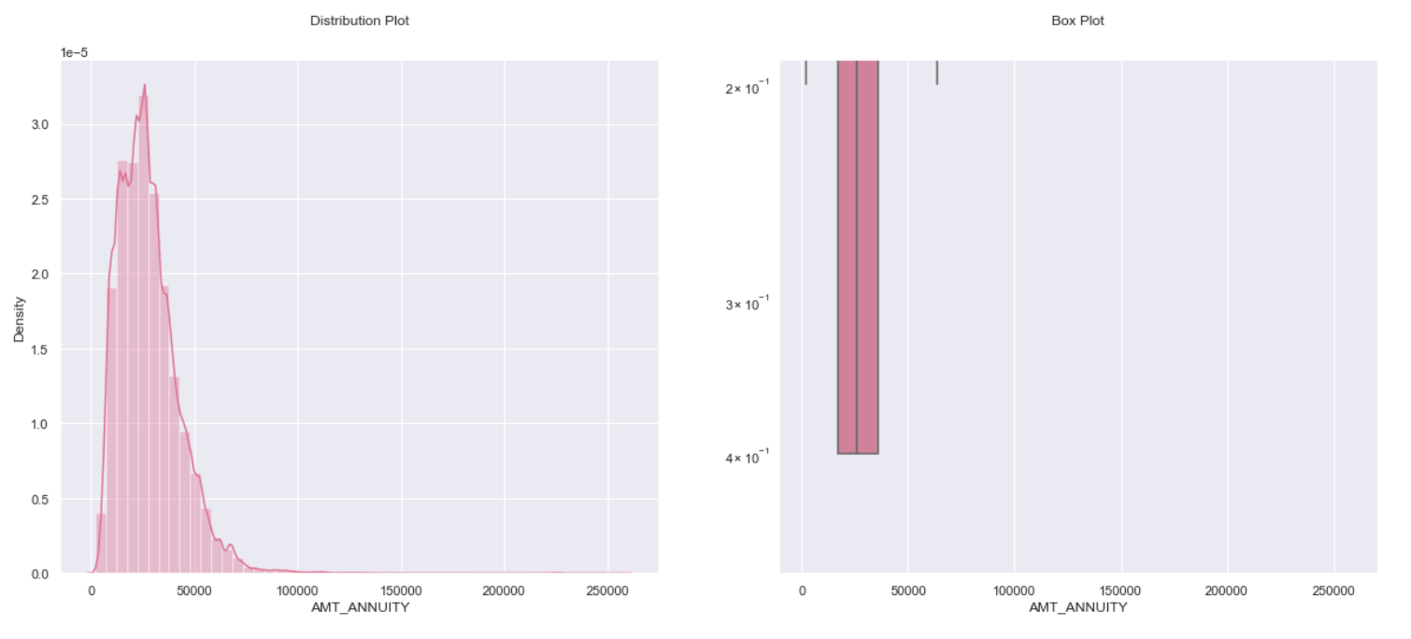
We observe that there are
Some outliers, and the curve
is not normal or a bell curve

Slide 21
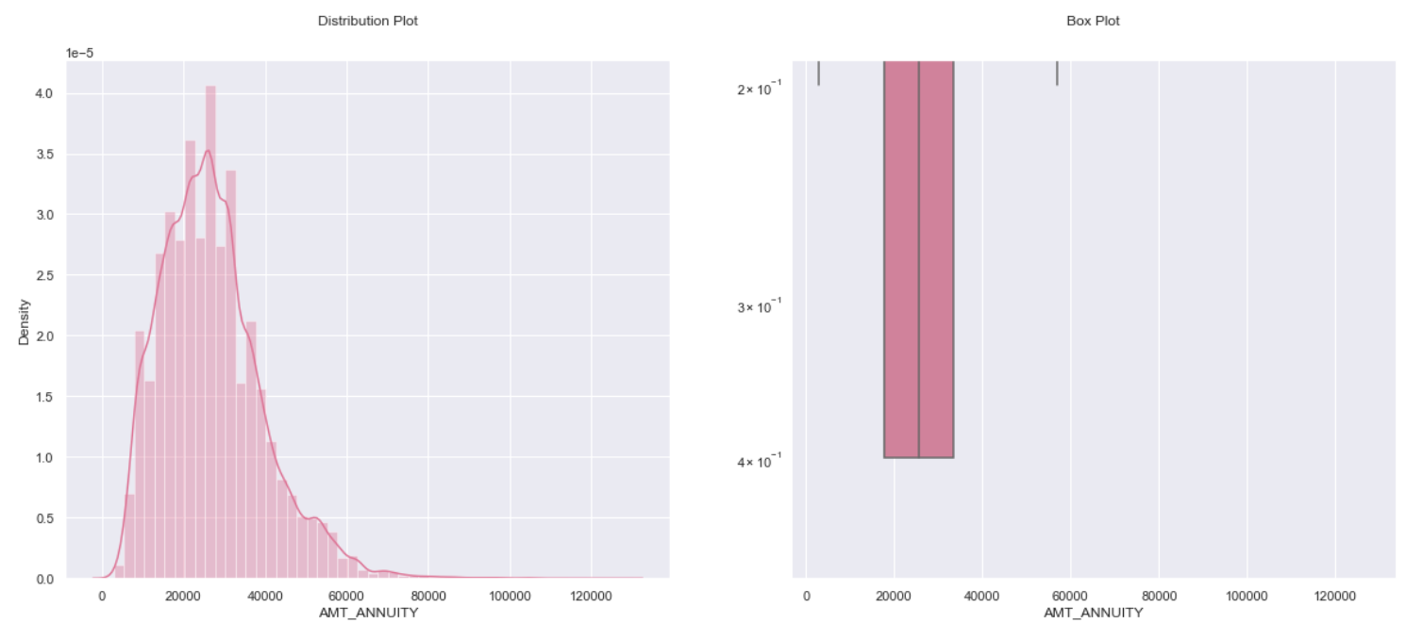
We observe that there are
Some outliers, and the curve
is not normal or a bell curve

Slide 22
BIVARIATE ANALYSIS OF NUMERICAL VARIABLES

Slide 23
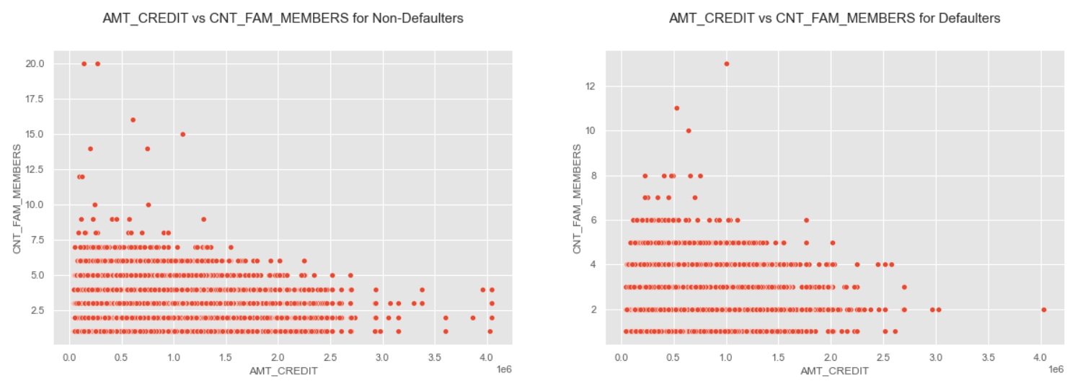
AMOUNT CREDIT VS COUNT OF FAMILY MEMBERS FOR PAYMENTS
We can see that the density in the lower left corner is similar in both the case, so the people are equally likely to default if the family is small and the AMT_CREDIT is low. We can observe that larger families and people with larger AMT_CREDIT default less often

Slide 24
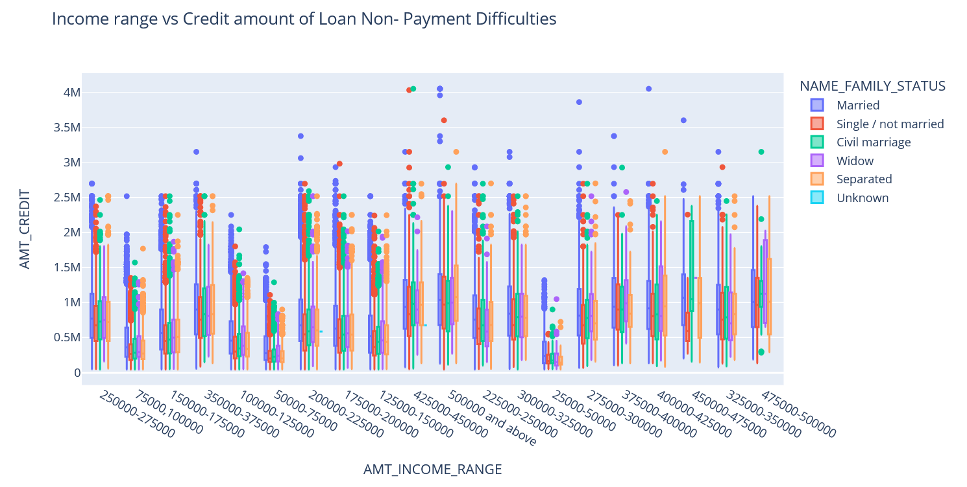
INCOME RANGE VS CREDIT AMOUNT OF LOAN BY NON-PAYMENT DIFFICULTIES
We observe that Family status of 'single', ‘Separated' and 'married' of income range very high are having higher number of credits than others. Thus, married family status has higher chances of payment thus non defaulters

Slide 25
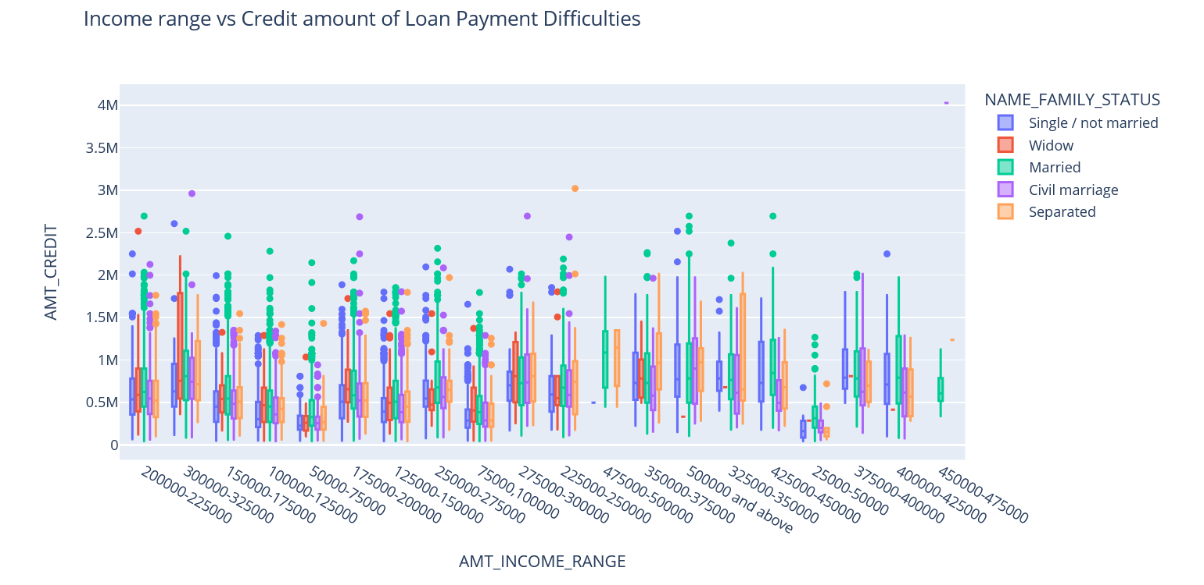
INCOME RANGE VS CREDIT AMOUNT OF LOAN BY PAYMENT DIFFICULTIES
We observe that Family status of 'single', ‘separated' and 'married' of income range very high are having higher number of credits than others. Thus, widowed and Separated individuals have a high defaulter rates thus are not safe loans

Slide 26
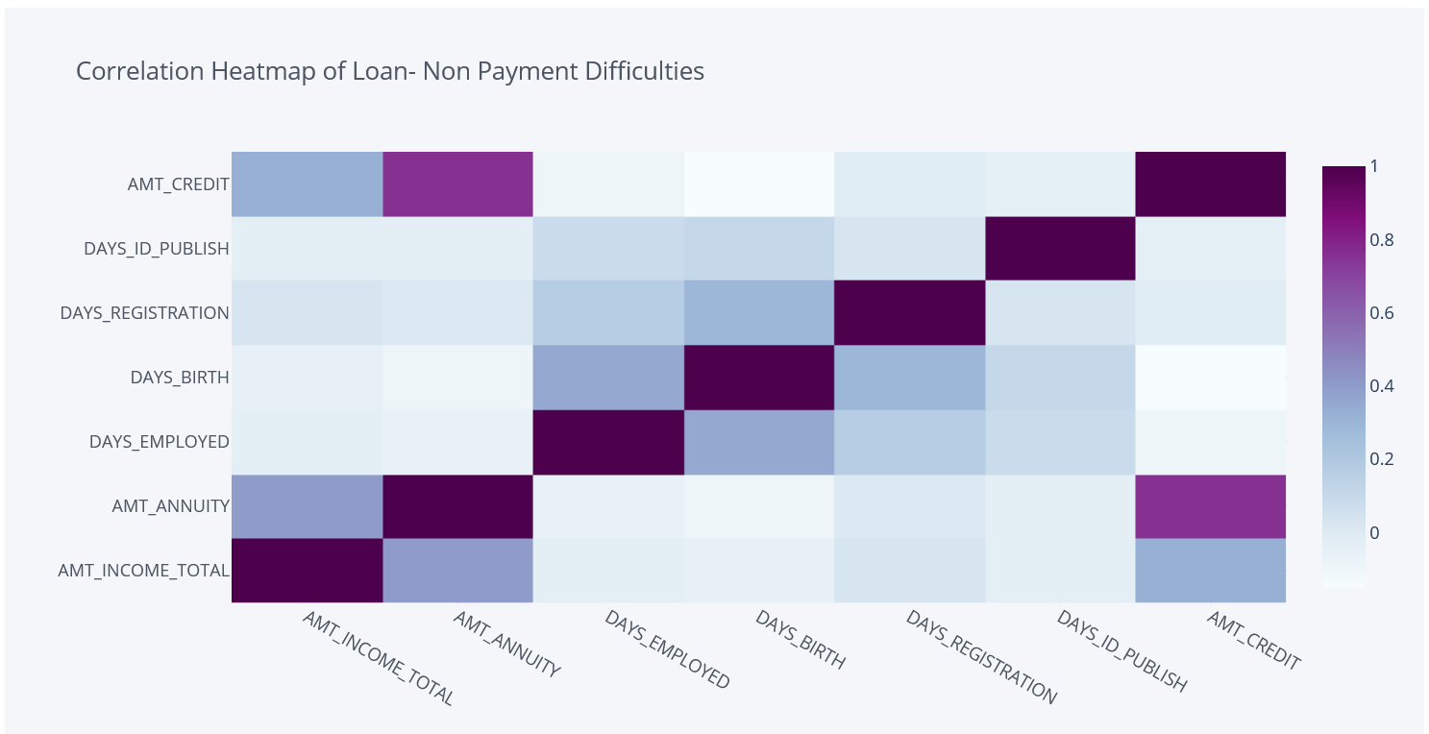
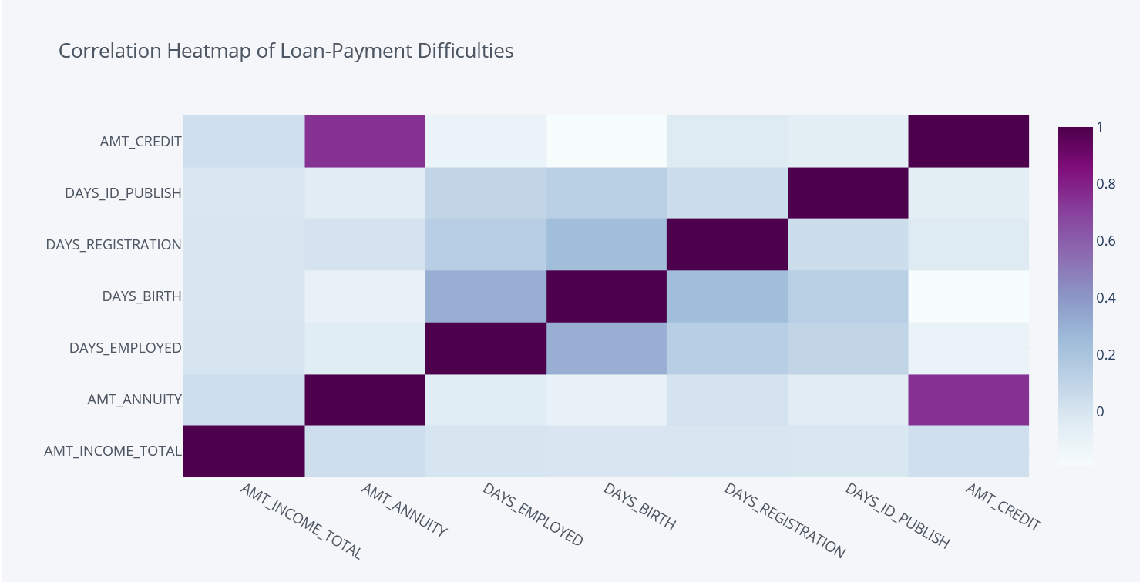
CORRELATION HEATMAP OF PAYMENT DIFFICULITES
We observe that there is a high correlation between credit amount and goods price. There appears to be some deviancies in the correlation of Loan-Payment Difficulties and Loan- Non-Payment Difficulties such as credit amount v/s income.

Slide 27
BIVARIATE ANALISYS MERGED DATASET

Slide 28
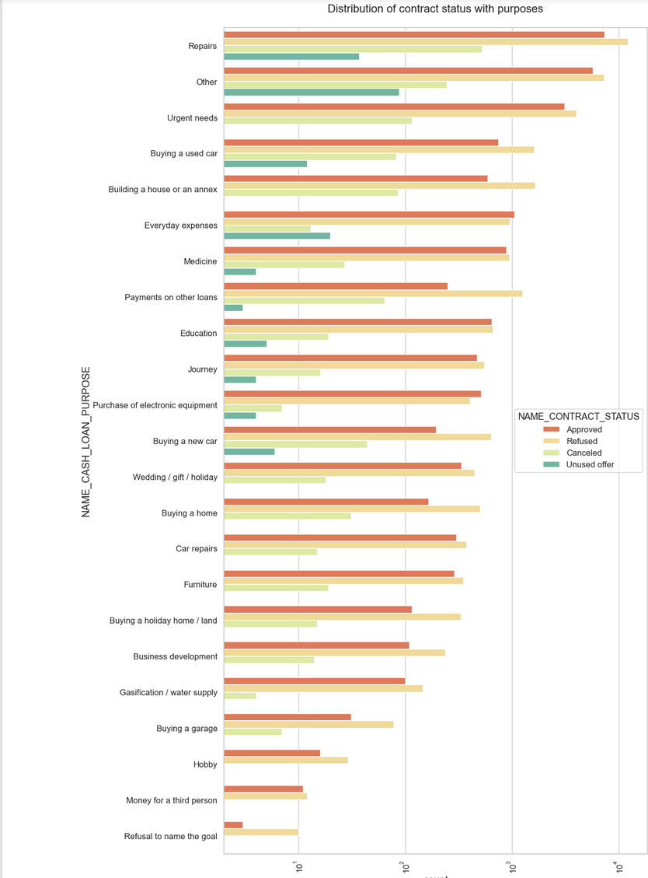
DISTRIBUTION OF CONTRACT STATUS WITH PURPOSE
Most rejection of loans came from purpose 'repairs'.
For education purposes we have equal number of approves and rejection
Paying other loans and buying a new car is having significant higher rejection than approves.

Slide 29
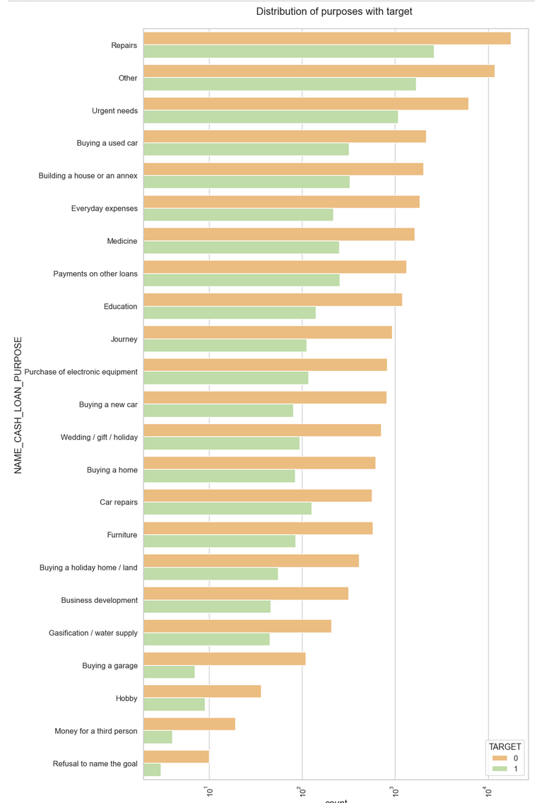
DISTRIBUTION OF CONTRACT STATUS WITH PURPOSE
Loan purposes with 'Repairs' are facing more difficulties in payment on time.
There are few places where loan payment is significantly higher than facing difficulties. They are 'Buying a garage', 'Business development', 'Buying land', 'Buying a new car' and 'Education' Hence we can focus on these purposes for which the client is having for minimal payment difficulties.

Slide 30
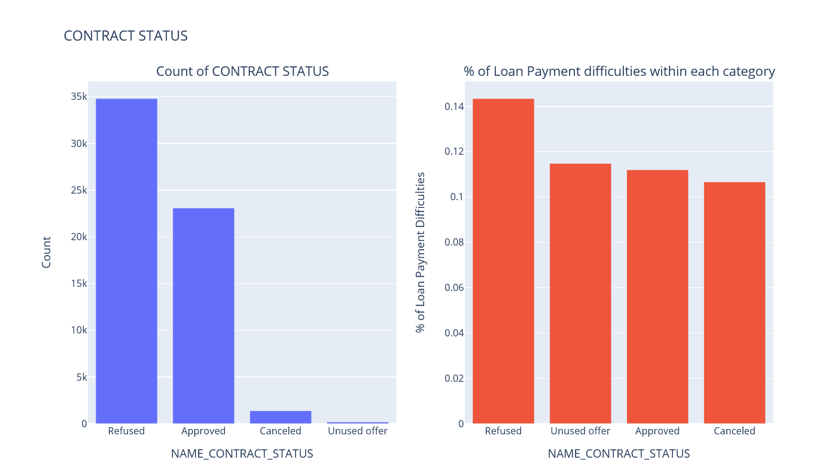
Distribution of Contract Status and its category with maximum % of Loan-Payment Difficulties
It can be clearly seen from the second graph that the
'Refused' contracts from previous application are the ones who have maximum % of Loan-Payment Difficulties from current application.
'Approved' contracts from previous application are the ones who have minimum % of Loan-Payment Difficulties from current application.

Slide 31
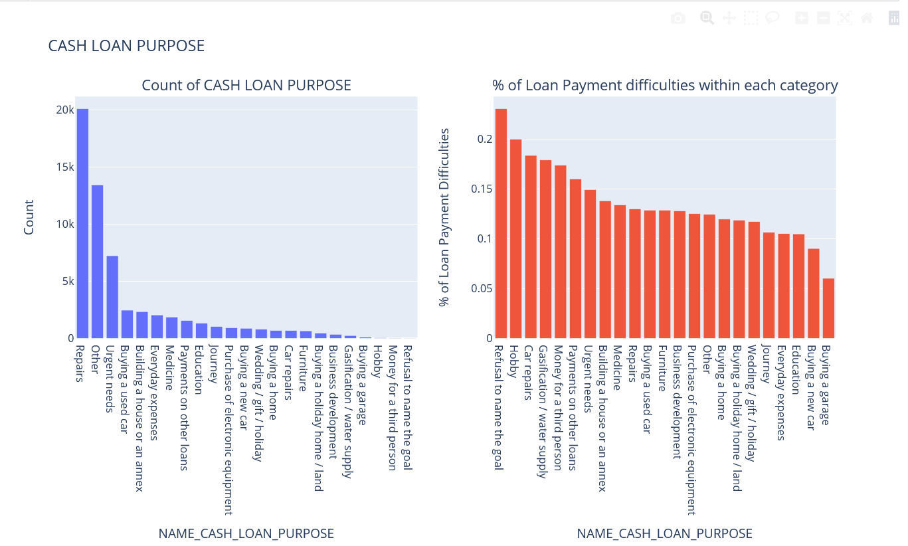
DISTRIBUTION OF CASH LOAN PURPOSE AND ITS CATEGORY WITH MAXIMUM LOAN PAYMENT DIFFICULTIES
From the first graph purpose of cash loan from previous data was maximum for 'Repairs'
It can be clearly seen from the second graph that the
'Refusal to name the goal' for cash loan from previous application are the ones who have maximum % of Loan-Payment Difficulties from current application.

Slide 32
RECOMMENDATIONS
The analysis performed above gave a lot of insights as to when and how the bank should approve loans and also many factors play into the same. The recommended group of people that will have a less chance of being defaulters are :
Clients with higher education ( Females)
Clients with higher income category
Widow who has unused previous loan status
Old people of any income group
Refreshed client who has unused loan status previously
Clients who are working as state servant
People with married status up to a particular extent

Slide 33
Following group of people are the clients which have a higher chances of defaulting that is the risky group :
Male Clients with Civil Marriages
Previously refused loan status group
Students going for secondary studies
Clients living on rent/with parents (Less incomes -> high chances of defaulting)
Lower educated clients with previous loans cancelled or refused

Slide 34
THANK YOU

